Slide 1
SYS366
Requirements Gathering
using OO Models
Week 2 Lecture

Slide 2
Outline
Systems Analysts
Requirements
Stakeholders

Slide 3
Objectives
Systems Analysts
Roles of a Systems Analyst
Requirements
Levels of Requirements
Requirements gathering
Requirements management
Stakeholders
Importance of Stakeholders
Non-human Stakeholders

Slide 4
Systems Analyst
An IT professional involved in the development of a computerized solution to a business problem.
Requires extensive business and people knowledge, with strong communication and technical skills.
Responsible for initial requirements analysis of a system development project.
Focuses on understanding the business problem
Focuses on the approach to be taken to solve the business problem

Slide 5
Systems Analysts Problem Solving Approach
Research and understand the problem
Verify that the benefits of solving the problem outweigh the costs
Develop a set of possible solutions (alternatives)
Decide which solution is best and make a recommendation
Define the details of the chosen solution, and assist in implementation
Monitor to make sure that the desired results are obtained
Collaborate with other members of the project team & stakeholders.
“Must thoroughly understand the problem the system will solve”

Slide 6
Systems Analyst Skills
Technical Knowledge and Skills
Business Knowledge and Skills
People Knowledge and Skills
Communication Skills
Integrity & Ethics

Slide 7
Requirements
In Software development, a requirement is a singular documented physical or functional need that a system aims to satisfy.
It is a condition or capability needed by a user to solve a problem or achieve an objective with a system.
2. A condition or capability that must be met or possessed by a system.
A requirement is simply a specification of a need or want.
Requirements must be documented.
Notes:
Software Requirements, Second Edition Karl E.
Hello, Phil? This is Maria in Human Resources. We’re having a problem with the employee system
you programmed for us. An employee just changed her name to Sparkle Starlight, and we can’t get
the system to accept the name change. Can you help?”
“She married some guy named Starlight?”
“No, she didn’t get married, just changed her name,” Maria replied. “That’s the problem. It looks like
we can change a name only if someone’s marital status changes.”
“Well, yeah, I never thought someone might just change her name. I don’t remember you telling me
about this possibility when we talked about the system. That’s why you can get to the Change Name
dialog box only from the Change Marital Status dialog box,” Phil said.
“I assumed you knew that people could legally change their name anytime they like,” responded
Maria. “We have to straighten this out by Friday or Sparkle won’t be able to cash her paycheck. Can
you fix the bug by then?”
“It’s not a bug!” Phil retorted. “I never knew you needed this capability. I’m busy on the new per-
formance evaluation system. I think I have some other change requests for the employee system
here, too.” [sound of rustling paper] “Yeah, here’s another one. I can probably fix it by the end of the
month, but not within a week. Sorry about that. Next time, tell me these things earlier and please
write them down.”
“What am I supposed to tell Sparkle?” demanded Maria. “She’s really going to be ticked if she can’t
cash her check.”
“Hey, Maria, it’s not my fault,” Phil protested. “If you’d told me in the first place that you had to be
able to change someone’s name at any time, this wouldn’t have happened. You can’t blame me for
not reading your mind.”
Angry and resigned, Maria snapped, “Yeah, well, this is the kind of thing that makes me hate computer systems. Call me as soon as you get it fixed, will you?

Slide 8
Levels of Requirements
There are three distinct levels:
Business requirements,
User requirements, and
Functional requirements.
In addition, every system has an associated nonfunctional requirements.

Slide 9
Business requirements
This represent the high-level objectives of the organization or customer who requests the system.
Business requirements typically come from the funding sponsor of a project, the acquiring customer, or the manager of the actual users.
Business requirements describe why the organization is implementing the system, and the objectives the organization hopes to achieve.
Business requirements can be recorded in a Business requirements Documents (BRD) or a project charter

Slide 10
Business Requirements Examples
A company needs a new sales system.
A company needs data to be consistent.
A bank needs a screen for entering customer contacts.
A bank needs an improved online banking platform
A marketing company needs an accurate monthly sales forecast.
An insurance company needs an improved automated claim processing system

Slide 11
User Requirement
User requirements describe user goals or tasks that the users must be able to perform with the product.
Valuable ways to represent user requirements include use cases, scenario descriptions, and event-response tables.
User requirements describe what the user will be able to do with the system.
An example of a use case is “Make a Reservation” using an airline, a rental car, or a hotel Web site.
Other examples, make an online claim submission to an insurance company; make an online bank transfer.

Slide 12
Functional Requirements
Functional requirements specify the software functionality that the developers must build into the product to enable users to accomplish their tasks, thereby satisfying the business requirements.
They are the traditional “shall” statements: “The system shall e-mail a reservation confirmation to the user.” The system shall generate a receipt upon completion of online bank transfer.
Functional Requirements simply specify what the system should be able to do.
Functional requirements are documented in a software requirements specification (SRS) document, which describes as fully as necessary the expected behavior of the software system.
The SRS is used in overall design, development, testing, quality assurance, project management, and all other related project functions.
The SRS also contains nonfunctional requirements.

Slide 13
Non-Functional Requirements
The Nonfunctional requirements specify the characteristics of a system, or how the system will do what it is expected to do. These characteristics include
Usability
Portability
Integrity
Efficiency
Security
Reliability.
Non-functional requirements describe how the system works, while functional requirements describe what the system should do.

Slide 14
Requirements Gathering
This is simply the act of gathering requirements from stakeholders in order to clearly understand what a proposed system is going to accomplish.
Requirements Gathering do not include:
Systems Analysis & Design
Implementation details
Project planning information
Testing information etc.
The requirements activities focus on understanding what the team intends to build and what the business wants to achieve with the system.

Slide 15
Requirements Management
Requirements management entails “establishing and maintaining an agreement with the customer on the requirements for a software project”
The developers also must accept the specifications and agree to build them into a product.
It entails keeping record of the documented requirements throughout the SDLC.

Slide 16
Functional & Non-Functional Requirements at a glance
The what and the why.
Functional Requirements describe the what
While Non functional requirements describe the how

Slide 17
Common Issues in Requirements
•The project’s vision and scope are never clearly defined.
•Customers are too busy to spend time working with analysts or developers on the requirements.
•User surrogates, such as product managers, development managers, user managers, or marketers, claim to speak for the users, but they don’t accurately represent user needs.
•Requirements exist in the heads of “the experts” in your organization and are never written down.
•Customers claim that all requirements are critical, so they don’t prioritize them.
•Your customers sign off on the requirements and then change them continuously.
•The project scope increases when you accept requirements changes, but the schedule slips because no additional resources are provided and no functionality is removed.
•Customers request certain functionality and developers build it, but no one ever uses it.
•The specification is satisfied, but the customer is not.

Slide 18

Introducing Stakeholders

Slide 19
First things first!
Before you can start determining how a business or system works (or will work), you must understand the stakeholder community
To deliver an effective solution, one that will be wholeheartedly accepted by the stakeholder community, you must have a clear understanding of the stakeholders and their particular needs
It is also important that the people asked to become involved in the project understand the role that they are expected to play and the responsibilities that they are expected to fulfull.
Bittner & Spence, p 50.

Slide 20
Who is a Stakeholder?
Stakeholder:
An individual who is materially affected by the outcome of the system (or business) or the project(s) producing the system
Note that this definition comprises individuals both directly affected by the business or system as well as those that are indirectly affected by their involvement in the project
Bittner & Spence, p 51.

Slide 21
Why are stakeholders interested?
Generally, a stakeholder expects to get something of value from a system.
They will be affected by the outcome of a system
The can be positively or negatively affected depending on the outcome of a project

Slide 22
How do we determine stakeholders?
The full set of stakeholders is very large; we have to remember to include:
The people who suffer from the problem;
Those investing in the business or system;
People determining the success of the solution;
People who will benefit from the success
Key things to consider
Who is making decisions?
Who will get something from the business or system?

Slide 23
Stakeholder Examples
•Customers who fund a project or acquire a product to satisfy their organization’s business ob-
jectives.
•Users who interact directly or indirectly with the product (a subclass of customers).
•Requirements analysts who write the requirements and communicate them to the development
community.
•Designers and Developers who design, implement, and maintain the product.
•Testers who determine whether the product behaves as intended.
•Documentation writers who produce user manuals, training materials, and help systems.
•Project managers who plan the project and guide the development team to a successful delivery.
•Legal staff who ensure that the product complies with all pertinent laws and regulations.
•Manufacturing people who must build the products that contain software.
•Sales, marketing, field support, help desk, and other people who will have to work with the
product and its customers.

Slide 24
How do we determine Stakeholders?
Organizational charts
Business Rules Analysis
Document Analysis
Who uses the documents?
Interviews
Lessons leaned from previous projects
Mind Mapping
Organizational Modelling
Process Modelling
Risk Analysis and Management
Scope Modelling (who’s in or out)
Survey or Questionnaires
Workshops

Slide 25
Stakeholder Representatives
There can be many hundreds or thousands of stakeholders involved in a project, and it is often impossible to speak with every stakeholder.
So, we can recruit a set of stakeholder representatives to be directly involved in a project.
This will ideally allow us to involve many different stakeholder roles, without having to deal with every person.

Slide 26
Importance of Stakeholders
Level of experience that a Stakeholder has in communicating their needs can make or break a project!
Stakeholders with positive attitudes can be strong project champions.
Stakeholders direct involvements most times helps to make the project

Slide 27
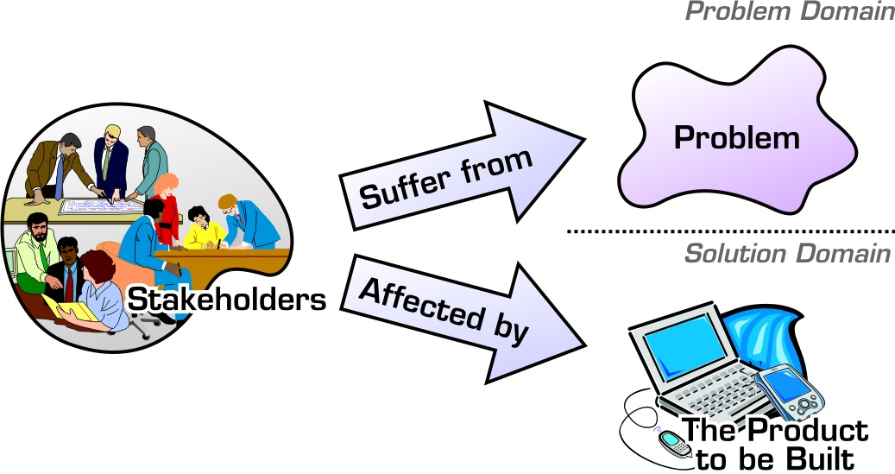
Stakeholders drive our project!
Stakeholders are important because it is their needs that the systems analyst must understand and address in order to solve the business problem.
Bittner & Spence, p 52.

Slide 28
Non-human Stakeholders
Aside from the people involved, there are some non-human stakeholders that must sometimes be considered:
Mechanical devices that the system must interact with
Other business areas
Other systems
Bittner & Spence, p 50.

Slide 29
Stakeholder List
Ensures that Stakeholders are not overlooked
All needs will be uncovered in a timely fashion
Discovering needs once requirements are documented leads to increased costs and stakeholder dissatisfaction

Slide 30
Stakeholder Matrix
High
Work closely with
stakeholder to ensure
that they are in
agreement with and
support the change
Ensure Stakeholder
remains satisfied
Influence of
Stakeholder
Monitor to ensure
stakeholders interest
or influence do not
change
Keep Informed;
stakeholder is likely
to be very concerned
and may feel anxious
about lack of control
Low
High
Impact on Stakeholder

Slide 31
In Summation
Each and every project requires focused stakeholder involvement. For all projects:
Active stakeholder involvment is imperative.
A collaborative and cooperative approach involving all the stakeholders is essential.
Remember: The stakeholders own the problem and are the source of the project's requirements. If the system is not a success with the stakeholders, then it is not a success.
Bittner & Spence, p 58.

